Slide 1
Principles of Macro economics 2
ECONA- 202
Inflation

Slide 2
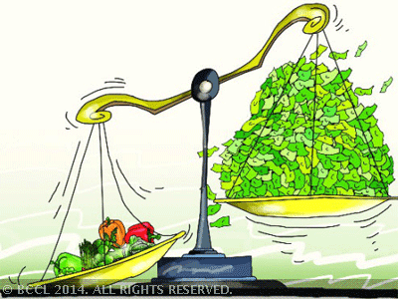

Slide 3
Introduction
Inflation is defined as a sustained increase in the price level or a fall in the value of money.
When the level of currency of a country exceeds the level of production, inflation occurs.
Value of money depreciates with the occurrence of inflation.

Slide 4
Causes
When demand for a commodity in the market exceeds its supply, the excess demand will push up the price (‘demand-pull inflation’).
When factor prices rise, costs of production rise (‘cost-push inflation’)

Slide 5
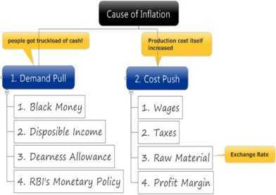
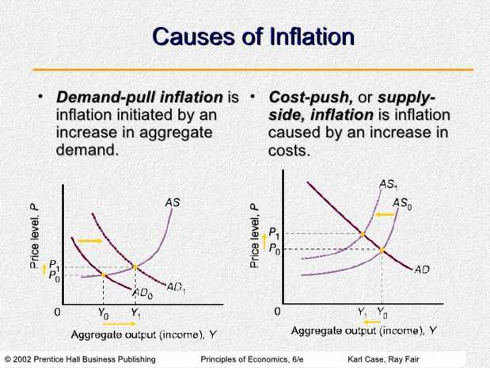
Causes

Slide 6
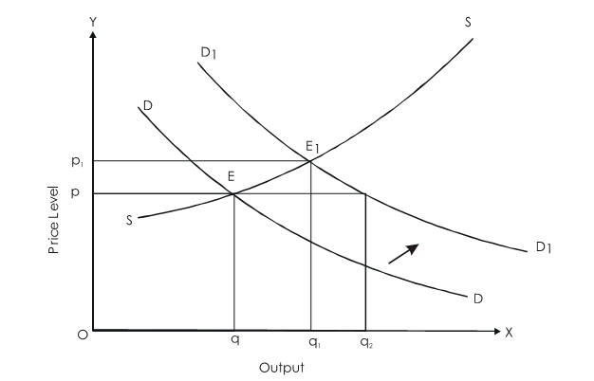
Demand Pull Inflation

Slide 7
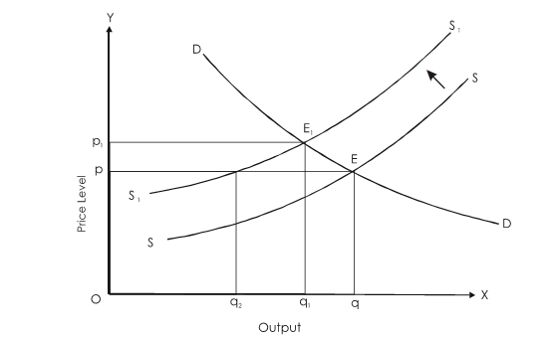
Cost Push Inflation

Slide 8


